Slide 1
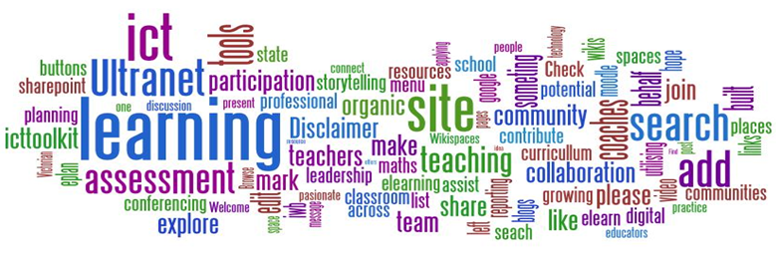
Cambridge TECHNICALS LEVEL 3
2016
1.4 – People in Business

Slide 2
RELATED ACTIVITIES
e
This Unit | Title of suggested activity | Other units/LOs
LO4 | Communication skills Communication technology Personal attributes and job roles Ready for work Professional bodies Industry certification | Unit 4 Computer networks | LO1 Understand the concept of networks LO2 Be able to plan computer networks to meet client requirements LO3 Be able to present network solutions to clients LO4 Be able to plan maintenance activities for computer networks
 |  | Unit 20 IT technical support | LO1 Understand the role of technical support LO2 Be able to diagnose faults and solutions for computer systems LO3 Be able to provide advice and guidance to specific customers
 |  | Unit 21 Web design and prototyping | LO1 Understand the fundamentals of web design LO4 Be able to present the interactive website concept to an identified client
 |  | Unit 22 Big Data analytics | LO1 Understand the scope of Big Data LO2 Be able to process Big Data for business purposes LO3 Be able to provide information resulting from processing Big Data

Slide 3
RELATED ACTIVITIES
e
Explanations of the key terms used within this unit, in the context of this unit
Key term | Explanation
Change management | Change management is a systematic approach to dealing with change, both from the perspective of an organisation and on the individual level. http://searchcio. techtarget.com/definition/change-management
Hybrid cloud | Hybrid cloud is a cloud computing environment which uses a mix of on-premises, private cloud and public cloud services with orchestration between the two platforms. By allowing workloads to move between private and public clouds as computing needs and costs change, hybrid cloud gives businesses greater flexibility and more data deployment options. http://whatis.techtarget.com/definitions/H/page/7
Hypervisor | A hypervisor is a hardware virtualisation technique that allows multiple guest operating systems (OS) to run on a single host system at the same time. The guest OS shares the hardware of the host computer, such that each OS appears to have its own processor, memory and other hardware resources. A hypervisor is also known as a Virtual Machine Manager (VMM). http://www.techopedia.com/definition/4790/hypervisor
Internet of Things | The Internet of Things (IoT) is a computing concept that describes a future where everyday physical objects will be connected to the Internet and be able to identify themselves to other devices. http://www.techopedia.com/definition/28247/internet-of-things-iot
Privacy filter | A privacy filter is a panel or filter that is placed over a display to make it difficult or impossible for someone to see the screen without being directly in front of the display. http://www.computerhope.com/jargon/p/privfilt.htm
RFID | Radio-Frequency Identification (RFID) is a system used to track objects, people, or animals using tags that respond to radio waves. RFID tags are integrated circuits that include a small antenna. They are typically small enough that they are not easily noticeable and therefore can be placed on many types of objects. http://techterms.com/definition/rfid
Social engineering | Social engineering is a non-technical method of intrusion used by hackers that relies heavily on human interaction and often involves tricking people into breaking normal security procedures. http://searchsecurity.techtarget.com/definition/social-engineering
VoIP | Voice over Internet Protocol (VoIP) is a technology that allows telephone calls to be made over computer networks like the Internet. http://compnetworking.about.com/cs/voicefaxoverip/g/bldef_voip.htm

Slide 4
Assignment Scenario
There are 6 sections to this Theory Unit, each of which will give you a basic understanding and practice at possible exam questions. It will involve gaining knowledge towards the answers.
This is not a wrote learning course, you will need to understand the basics of ICT in order to adapt your knowledge towards companies and their needs. For LO4, this will involve understanding:
Communication skills
Communication technology
Personal attributes and job roles
Ready for work
Professional bodies
Industry certification
In the exam you will be given precise questions requiring precise answers based on a scenario to answers questions from, and adapt your knowledge and use the key terms and named components to give a judgemental answer.

Slide 5
4.1 – Communication Skills
Within the business environment, an employee must highlight and evidence a range of skills to ensure they remain professional and able. These skills are not always learned from courses but through experience, developed and improved through time. For this task you will create and demonstrate to an audience, the skills that add up to being interpersonal and skillful in terms of communication.
Verbal Conversations / Exchanges – How a member of staff interacts with customers and other staff members, how a subordinate deals with a superior, how to be casual or professional.
Questioning Techniques – How to get the best answer, how not to lead, how to use qualitative and quantitative questioning techniques.
Interpersonal Skills - Skills that are fundamental to successful relationships at home, at school, at work and socially.
Written Communication – How to write an email, etiquette, how to phrase a letter for business vs personal purposes, do’s and don’ts of SMS and Blogging
In all business context there is a way and means of how to communicate and choosing the most appropriate for a given situation.
In the exam you will be given a situation and asked to choose an appropriate method and style.
Learning body language allows a user to manipulate a conversation. Best method for interviews Does eye contact work or does it make things awkward Email and letter etiquette The difference between an A grade and C grade student is how they respond to feedback Why wee should all ways spell and grammer cheque.

Slide 6
4.1 – Communication Skills - Verbal
When presenting information on the different forms of verbal communications, you need to consider and discuss the 3 different methods:
In terms of the way we communicate this information we need to be wary of:
How we present ourselves during a conversation, delivery or presentation makes a difference. This is not just about the audience hearing the words but about them understanding, empathising, being entertained or informed. Gestures like holding your arms out wide means ‘Everything’, closed hands in prayer means ‘trust’, arms crossed means ‘defensive’, hands in pockets means ‘not true’. Click here for guidance.
Task 01 – Create a presentation on how to present using techniques that can benefit interpersonal and communication skills development.
Learning body language allows a user to manipulate a conversation. Best method for interviews Does eye contact work or does it make things awkward Email and letter etiquette The difference between an A grade and C grade student is how they respond to feedback Why wee should all ways spell and grammer cheque.
VERBAL (TECHNICAL & NON-TECHNICAL)
Face-to-Face (meetings, interviews, discussion, etc...) Telephone Presentations
Verbal | Lip Reading | Signing | Tone
Intonation | Use of Body Language (Head / Eyes / Hands / Nodding) | Summarising | Paraphrasing

Slide 7
4.1 – Communication Skills - Questioning
When presenting information about the different forms of Questioning Techniques, you need to consider the manner of questions and responses, for instance:
For instance, closed questions are useful but do not engage the audience, questions with too many similar responses means the audience gets sloppy answering. Not having qualitative answers after closed questions means the audience will not feel appreciated or rewarded for answering.
Based on the forms of Questioning Techniques presented above, relate them to:
Behaviour Awareness - Adapting delivery based on the reactions of the audience is a skill used by presenters. Too much information can overload them, too little can make them feel demeaned.
Culturally - Things that are acceptable as a tool is not always acceptable in other cultures. For instance looking at the eyes of the audience is goo in the UK but not in the Far East. Click here for a guide on Do’s and Don’ts.
Understanding – Setting the bar too high, or too low, you need to know your audience in order to benefit your audience. If you present information they already know, they will turn off, if you present information.
Task 02 – Discuss how Questioning techniques can benefit interpersonal and communication skills development.
Learning body language allows a user to manipulate a conversation. Best method for interviews Does eye contact work or does it make things awkward Email and letter etiquette The difference between an A grade and C grade student is how they respond to feedback Why wee should all ways spell and grammer cheque.
Open (difficult to analyse) | Closed (options) | Probing Questions (linked) | Response Times
Purpose | Understanding | Behaviour Awareness | Cultural Influence

Slide 8
4.1 – Interpersonal Skills - Problem Solving
In our professional and academic lives we solve problems on a daily basis, mostly without thinking that the skills we use and have learned are an asset to doing this. Some of the problems that you as a student typically faced include:
Structuring and adapting an argument for an essay
Researching how companies manage a business situation
Dealing with an awkward situation, student or educational request
Developing a strategy to reach the next stage of a project given to you
Analysing and Investigating – This is all about gathering relevant information systematically to establish facts and principles; problem solving a brief in order to determine a solution, researching the alternatives, breaking down key factors, structuring a solution that is appropriate for the client.
Creativity – This is generating and applying new ideas and solutions to the problem, finding different ways of achieving the same or better results. Bus does not come, do you find a new way home, client wants to reduce down the budget, how can you be creative in reducing expenditure.
Some steps of Problem Solving are fundamental:
Identify the Problem | Define the Problem | Examine the Options | Act on a Plan | Look at the Consequences

Slide 9
4.1 – Interpersonal Skills - Team Player
What makes a good team player?
Work and Team Playing ability – Being able to manage a situation for the best results
Having the ability to work confidently within a group and to inspire a work ethos in co-workers in order to achieve a goal
The ability to work with others (including different ages, cultures, work ethics etc) to deliver results as planned to customers and clients who may be from different backgrounds and at different stages of development, skill sets or levels of interest
Working with management and administration staff in order to achieve the best results that compromises company and customer needs
Commercial Awareness – To understand commercial realities and restrictions affecting the business
Knowing current trends (sales/ technologies/ government guidelines/ legislation/ customer needs/ short and long terms goals/ the market place and market trends)
Being aware of the style and ability of immediate rivals, taking this into consideration in terms of analysis and preparation
Pro-active – Being able to making things happen, pre-empting situations, showing initiative including active participation and contributions. Not everyone can be the team leader but everyone can contribute.
Co-operative – Being able to work well with others to get job done, compromising situations for a time planned result, knowing when to let go or take control, working parties, development groups, sharing company objectives through a wider scope of activity.
Responsibility - Being able to accept ownership of a situation, clarifying what you have done, owning the decisions and actions made so the action and responsibility can be attributed either successfully or unsuccessfully.

Slide 10
4.1 – Interpersonal Skills – Business Skills
Different business skills are required to be successful, such as illustrating:
Written Communications - to express yourself clearly in writing, grammatically correct, being able to set the tone, understand technical and commercial detail and communicate in the same manner.
Referring carefully to guidelines and planned activities and sticking to the plans.
Recording accurately achievements in order to learn from successes and remember failures.
Writing to stakeholders/shareholders in the language they understand, knowing technical information and commercial detail.
Numerical - Multiply/divide accurately and spontaneously, calculate percentages without thinking, use statistics and a calculator, interpret graphs and tables and adapt that understanding to the current scenario.
Computing – Being able to demonstrate skills such as Word-processing, using databases, spread sheets, the Internet and email, designing web pages etc. Being able to adapt this practical skill to use within a business or personal environment.
Written Communications | Verbal Communications | Numerical Skills | Computing Skills

Slide 11
4.1 – Interpersonal Skills – Business Skills
Verbal - Spoken and Non-Spoken Communication – This is the skill that gets you the job, CV’s and references and demonstration of skills gets you to the interview and past the practical part, verbal skills convinces others that you are the best candidate and includes being able to express your ideas clearly and confidently within a conversation, presentation or activity.
Body Language - using your body to effect, such as by using eye contact to show honesty, hand gestures to emphasise a point, head nodding to show understanding, smiling to show empathy and interest.
Listening - accurately hearing what people are saying and showing interest, being able to interpret as the conversation goes along, to show interest in what is being said, to generate empathy with the speaker.
Motivating and Supporting - giving encouragement in order to increase trust, giving thanks through praise or help, working well in a team by contributing, urging, collaborating.
Telephone Skills - being brief and keeping to the point in order to professionalise the conversation, consider in advance what to say, adapt a conversation according to circumstances, to emphasise without body language.
Gathering Information - ask open and probing questions to understand the views and feeling of others, to be able to clarify and summarise what others say so the results can be interpreted. Know how to lead questions in order to get the right answers, adapting on the spot to increase understanding.
Giving and Accepting Criticism - saying ‘sorry’ in a genuine way, allow disagreements to be brought into the open so they can be dealt with, be constructive if criticising, sandwich criticism with praise.
Persuading and Negotiating - back up your points with facts and logic, be tactful if anyone disagrees with you, being able to see both sides of an argument and sway judgement, being able to compromise for the good of the many.
Presenting - use a logical structure so it looks like you know what you are doping, be clear and concise so the audience does not get time to get bored, encourage questions for clarification and to engage the audience.
Global Skills - be able to speak and understand other languages so the customer feels rewarded and more secure in accuracy rather than lost in translation, show appreciation of other cultures, know the rules and laws of other countries to avoid making mistakes.

Slide 12
4.1 – Interpersonal Skills – Personal Skills
All jobs applications and CV’s ask for personal skills, what you have done on the outside, what you bring to the company in terms of your personality and how the company might make use of this. These are hard to prove so they have to seem believable on a CV and letter of application.
Flexibility - Adapt successfully to changing situations and environments, proving themselves will to adapt, to try different methods, to self improve for the sake of getting better. When choosing a team this is the person you want, the one who will try any task. To be flexible means to be willing and keenness inspires others.
Determination – this is like ambition, wanting to get things done and done right.
Hard Working – Determined people tend to take care with their work and persevere to complete tasks, they tend to push teams to do the same
Drive - Determination means to get things done, to make things happen and constantly looking for better ways of doing things. Drive means to have motivation for something, to respond to pressure with willingness and gusto.
Career Minded
Personal Impact/Confidence - Presents a strong, professional, positive image to others which inspires confidence and commands respect. Demonstrating confidence and impact tends to inspire, tends to make you stand out from the crowd. Employers like confident staff, confident staff deal with the issues and manage their own deadlines.
Lifelong Learning - Continues to learn throughout life. Develops the competencies needed for current and future roles. Employers like this because it shows a willingness to self improve, and whatever helps a member of staff be better, helps the company be better. All learnt improvements filter down to others, benefit teams, moves the company forward.

Slide 13
4.1 – Interpersonal Skills – Personal Ability
All jobs applications and CV’s ask for personal abilities, what you are like as a person, whether or not you are compatible with the company ethos, whether people will get on with you as a co-worker. These are hard to prove so they have to seem believable on a CV and interview.
Punctuality - always being on time or having things ready on time. Employers like this for two reasons, they are paying you to be on time and others will depend on you being there for their tasks. Not getting a task done on time filters down to others, getting them the blame, holding back their work, making teams unreliable or having someone take up the slack and so adding more work for them.
Being Respectful – there is a lot of things you just do not get with at work like you might at school, and demonstrating respect to employers is one of them. At a interview every action matters, every comment, every joke, all gets remembered. This is their company and they are proud of it, being disrespectful demeans this.
Honesty - acting truthfully at all times – Fool me once, etc. Companies rely on the honesty of their staff and the trust that is built up between staff and other staff and staff and customers. Lying to customers disrespects a company, the company gets labelled not the staff member.
Integrity - Adheres to standards and procedures, maintains confidentiality and questions inappropriate behaviour, acts in a way that is open and honest, is not easily influenced by others to act inappropriately. Integrity means trust and employers prefer to work with staff they can trust in terms of confidentiality and business functions.
Fairness - sticking to the rules without having a negative effect on others, being able to see both sides, being able to come down on the side of right rather than convenience. This comes with integrity and being honest.
Dependability - People know you will do the job and do it well, they place a trust that you will get it done and therefor will work on that assumption. Staff rely on other staff, jobs often rely on other jobs getting done, the pressure in Business to achieve for the larger goal is always there.
Reliable - people can trust you and in your work and do it right, reliable is not always about being on time but about doing it properly, finished, to the quality and standards expected. This is one word that should be on your letter of recommendation, if means the company trusted you.
Professionalism - Pays care and attention to quality of work / supports and empower others, behaves in a manner that is in keeping with the employment and employer. Lawyers do not gossip, nor doctors, teachers do not joke about their students to other students, every employment have a professional standard they expect staff to live up to.
Stress Tolerance - Maintains effective performance under pressure, does not let it get to them, prioritises, manages the workload by some means.

Slide 14
4.1 – Interpersonal Skills – Leadership Qualities
Leadership Qualities – Now every job involves being a leader but the qualities of a leader are admired and recognised in any job. Good leadership requires deep human qualities, not necessarily management processes.
Examples of highly significant leadership qualities
This is a lot of qualities, any three of these can be seen at an interview. Interviewers do not just see what the job needs but what the staff can become, in a lot of professions progress within the business tarts after 3 years, Head of Department, team Leader, Supervisor etc. and these can be seen merely from Passion and Confidence.
Other qualities like Humility will be seen as Leadership is about negotiation, compromise as well as command.
Commitment and Passion are important as they serve confidence and ability, Compassion and Sensitivity go hand in hand with Wisdom and Sincerity.
All these interlinked traits can add up to a good leader and all companies that are successful have a good leader.
Integrity | Honesty | Humility | Courage
Commitment | Sincerity | Passion | Confidence
Positivity | Wisdom | Determination | Compassion
Sensitivity | Inspire Belief in Others | Charisma | Adaptability of Styles

Slide 15
4.1 – Interpersonal Skills – Planning and Organisation Skills
Planning and organisational Skills - Having the ability to plan and organise is something we all have - in fact, most of us use these skills on a daily basis. These include:
Researching - identify possibilities, keep up to date with information, keep aware of developments or issues which could impact on your project
Prioritising - identify critical tasks, arrange tasks in a logical order, adapt and adjust plans
Record Keeping - keep accurate records so that you know what has already been achieved or agreed and what needs doing, when, and by whom.
Time Management - manage time effectively, prioritising tasks and able to work to deadlines
Planning and Organising - adapt successfully to changing situations and environments, contribute ideas (in conjunction with team members) towards planning activities and effectively plan
Action Planning - decide what steps are needed to achieve goals and then implement them
The ability to multi-task - able to deal with more than one thing at a time, and be comfortable with challenge and variety
Interpersonal skills - ability to work well with other people (good communication skills and be confident and assertive, without being confrontational or aggressive)
Interpersonal sensitivity - Recognise and respect different idea - open and willing to adapt based on views

Slide 16
4.1 – Interpersonal Skills – Independent Workers
Most jobs value staff who can work on their own steam, who can be independent just as much as they value staff who can be team players. Independent skills means the person can finish the task, will take personal responsibility for doing so, will feel obliged and manage the pressure. Staff within most jobs will spend some time working alone, being able to achieve within this timeframe is going to be beneficial to a company.
Independent - not needing to rely on others to get a job done, multitasks, accepts responsibility for views and actions and able to work under their own direction and initiative. Manages work-loads, sets personal deadlines.
Self Awareness - awareness of achievements, abilities, values and weaknesses and what you want out of life, demonstrates an understanding of the commercial realities affecting the organisation, knows their own limitations and asks for help when the limitation is met.
Self Motivation - able to act on self-initiative, to identify opportunities and be pro-active in putting forward ideas and solutions. Being ambitious, capable, reliable. Can inspire others with their work ethic.
Enthusiastic - showing real and genuine interest in the job, the company and the future. Happy to help and support, keen to get the work done, on-time, goes beyond the call of duty and limitations of current knowledge to go further, read more, understand more. Inspiring.

Slide 17
4.1 – Interpersonal Skills – Report
It is tough enough to get a job in the real world, to know what an employer is looking for on a CV, to know what to put into the letter of application. All companies differ in what they are looking for in a member of staff, and all jobs are different, requiring different attributes depending on the nature of the job. Think of the different levels of expectations that is required by a teacher through the years at Secondary Education, a high level of subject knowledge at 6th form, a better means of adapting information for a target audience at year 07, crowd control and a compromise at Year 10 and 11.
Similarly in business there are different clients that require a different level of managing, a customer at the till, a manager within the company, corporate clients, stakeholders, suppliers etc. Having the friendliness to deal with a till customer is not the same required skill as the degree of professional management as dealing with corporate customers, this requires a different level of maturity, of professional language, of dress code and appearance and a different level of preparation necessary to produce the same result, a happy client.
Task 03 – Produce a report that identifies and explains the different personal attributes required during a candidates employability.
This report needs to discuss the attributes an employer values and the employability skill sets of the the following:
Title and Index | Introduction | Problem Solving | Team Player
Business Skills | Independent Working | Personal Skills | Personal Abilities
Leadership Qualities | Planning and Organisational Skills

Slide 18
4.1 – Communication Skills – Your Skills
Now you are on a career path you should calculate whether you have developed your skills towards the ideal Job or Future Career opportunity.
Please complete the following table with areas in which you feel you could develop your skills. These could include skills such as presenting, team work, leadership as well as your reading / written / verbal skills. Make sure that you set your priority focus and suggest ways that you can judge success and where that evidence will be found.
Task 04 – Using the table, produce a personal development plan that outlines your personal and business skills in line with an ideal but realistic job.
Development Need | Priority | Current Ability | Target Ability | Development Opportunity | Criteria for judging success | Time Scale | Where can evidence be found
1.
2.
3.
4.
5.
6.

Slide 19
4.1 – Communication Skills - Written Communication
There are multiple forms of written communication, each with benefits and disadvantages, each with a style they should be created with and common mistakes that are often made.
Using one of the above forms of communication you should present a guide to business use and be prepared to present this information to the class. Use the following headings for your guide.
Task 05 – Create a guide ion the form of a formal presentation that outlines the effectiveness of communicating written information to a business client.
Emails | Letters | Websites
Posters and Leaflets | SMS and Chat | Wikis and Blogs
The informal language used within email | Benefits of written communication in seeking feedback | Use of examples for the consideration of the target audience.
Use of questioning techniques to gain feedback | The benefit of using non-verbal communication for this purpose | How to overcome barriers through written communication.
Importance of open and closed questioning | Use of Intonation and Emphasis of important facts | Emphasis on summarising, paraphrasing and Questioning techniques.

Slide 20
4.2 – Communication Skills - Written Communication
There are multiple forms of written communication, each with benefits and disadvantages, each with a style they should be created with and common mistakes that are often made.
Using one of the above forms of communication you should present a guide to business use and be prepared to present this information to the class. Use the following headings for your guide.
Task 05 – Create a guide ion the form of a formal presentation that outlines the effectiveness of communicating written information to a business client.
Emails | Letters | Websites
Posters and Leaflets | SMS and Chat | Wikis and Blogs
The informal language used within email | Benefits of written communication in seeking feedback | Use of examples for the consideration of the target audience.
Use of questioning techniques to gain feedback | The benefit of using non-verbal communication for this purpose | How to overcome barriers through written communication.
Importance of open and closed questioning | Use of Intonation and Emphasis of important facts | Emphasis on summarising, paraphrasing and Questioning techniques.

Slide 21
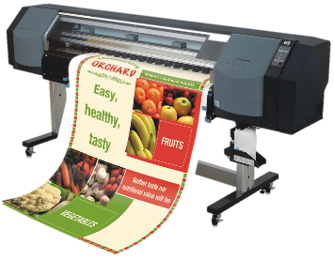
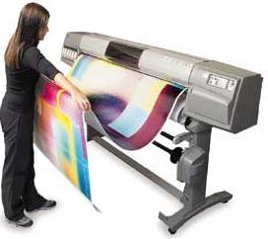
4.2 – Communication Technology - Websites
Rather than producing flyers and posters by printing them out, it is possible to use websites to do the advertising. This method requires the company to either develop their own websites or to pay another company to advertise on their website.
Using the first option requires the company to either employ a team of web designers to go to a specialist company with experience in website design. It will also ne necessary to buy hardware and software to develop and store the website.
This method can therefor be expensive, but the cost does not stop there. It will be necessary to use programmers to make sure that the website is safe from hackers and phishing attacks. The big advantage is that websites offer world-wide advertising capability and there is also no need to buy paper and other consumables or pay people to deliver leaflets or flyers.
Companies have to weigh up the advantages and disadvantages of both methods before they decide which is the best advertising method.

Slide 22
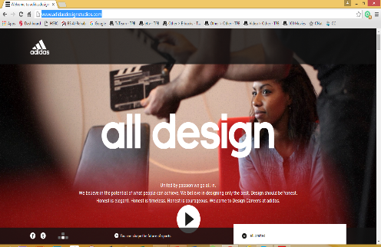
4.2 – Communication Technology - Websites
Advantages
Sound / video / animation can be added
Links to other websites / hyperlinks and use of hotspots
Buttons to navigate / move around the website leading to more information.
Hit counters to see how many people have visited the site.
Can be seen by a global audience.
Can’t be defaced or thrown away.
It is much easier to update a website (and there is no need to do a reprint and then distribute the new version).
Disadvantages
Websites can be hacked into, pharmed and modified or viruses introduced.
It is necessary for the potential customers to have a computer and internet connection.
It isn’t as portable as a paper-based system (although with modern smartphones and phablets this is becoming untrue)
Possible for customers to go to undesirable websites (either by accident or as a result of the pharming attack) - this can lead to distrust from customers.
There is a need for the company to maintain the website once it is set up – this can be expensive.
Because it is a global system, it is more difficult to target the correct audience using website advertising.

Slide 23
4.2 – Communication Technology – Presentation Software
Presentations that use animation, video and sound or music are generally much more interesting than a standard presentation done on slides of paper.
The presentations are produced using one of many software packages on the market and then used with a multimedia projector so that the whole audience is able to see the presentation.
Advantages
Use of sound and animation / video effects which are more likely to grab the attention of the audience, and can also make the presentation easier to understand.
It is possible to have interactive / hyperlinks built into presentations; this means the presentation could access a company’s website or even key files stored on the cloud (such as video footage, images, spreadsheets and so on).
Use of transition effects allow a presentation to display facts in a key or chronological order.
The presentation can be interactive.
They are more flexible; because of the links to websites and other external systems (e.g. the cloud), the presentation can be tailored to suit a particular audience.

Slide 24
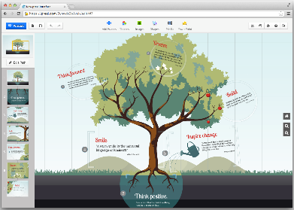
4.2 – Communication Technology – Presentation Software
Disadvantages
There is a need to have special equipment which can be expensive.
Equipment failure can be a disaster when giving multimedia presentations.
Wherever the presentation is given, there may need to be internet access.
There is a danger when using multimedia in presentations that the focus is on the medium (i.e. the multimedia presentation) rather than the message / facts.
It is very easy to make a bad presentation with too many animation effects and too much text or images.

Slide 25
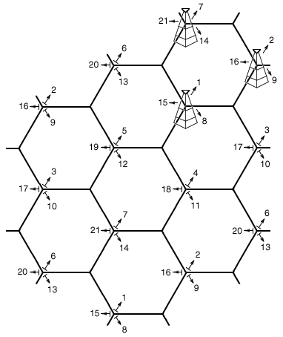
4.2 – Communication Technology – Mobiles and SMS
Page 88
Mobile Phones communicate by using towers inside many cells networked together to cover large areas. The towers allow the transmission of data throughout the mobile phone network.
Each tower transmits within its own cell; if you are driving a car and get to the edge of the cell the mobile phone signal starts to weaken, this is recognized by the network and the mobile phone then picks up the signal in one of the adjacent cells.
If a person making a call or sending a text to somebody in a different country, then satellite technology is used to enable the communication to take place.
Mobile phone technology can now be used by computers and tablets. A plug-in device (using a USB port) or SIM (subscriber Identity Module) card allows the computer to connect to the mobile phone network. This then allows access to the Internet.
Cell tower at the centre of each, each cell overlaps giving mobile phone coverage

Slide 26
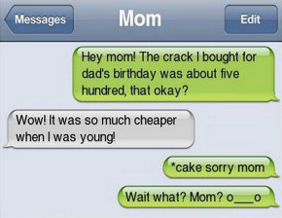
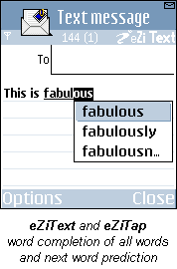
4.2 – Communication Technology – Mobiles and SMS
As a communication device, the mobile phone has many advantages.
They can be used to make phone calls from any location within the cellular network; this had advantages over the more conventional landline system:
There is no need to look for an operational public telephone in an emergency
It is possible to conduct business or personal phone calls on the move
It is easier to keep in contact with co-workers at the office no matter where you are.
They allow text messaging
This is quicker and less expensive than making phone calls
Also text messaging can be sent at any time of the day even if the recipient’s phone is turned off
They employ predictive texting where the system completes a word from a few letters keyed in, e.g. ‘preci’ and the phone completes the word as ‘precious’; predictive texting allows the system to remember frequently used words – increasing typing speed.
Mobile phones allow access to the internet on the move using the cellular network or a ‘Wi-Fi hotspot’.

Slide 27
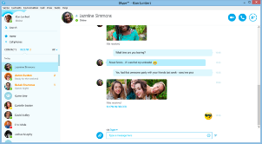
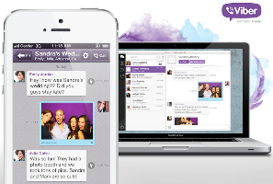
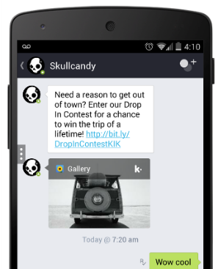
4.2 – Communication Technology – Video-Conferencing
One of the most common forms of internet telephony (i.e. having a telephone conversation via the internet) is Voice Over Internet Protocol (VoIP)
VoIP is a method used to talk to people using the internet. VoIP converts sound (picked up by the computer microphone or special VoIP telephone plugged into the computer USB port) into discrete digital packets which can be sent to their destination via the internet, One of the big advantages is that it is either free (if it is computer to computer talking using VoIP and microphone and speakers) or at a local rate to anywhere in the world (when VoIP is used to communicate with a mobile or landline number rather than a computer).
Obviously to work in real time the system requires a broadband ISP. The main problems are usually the sound quality (echo and weirds noises are common faults). Security is also a main concern with VoIP, as it is with other internet technologies.
One of the big advantages of using VoIP is that a webcam can be used so that it becomes a type of video chat. Whilst this does not have the sophistication of a video conference, it is much cheaper (no need for specialist software or additional hardware – VoIP uses built-in microphones, speakers and webcams). Usually the video quality is not very good, but this can be improved by using a more expensive USB webcam.

Slide 28
4.2 – Communication Technology – Email
Email has become the most common form of communication between people and businesses and accounts for 10% of all Internet traffic.
Acceptable Language
The language used by people when writing emails must be within an acceptable code of practice. The following is a list of unacceptable content to be used in emails, text messages and online forums:
Obscene images
Language that is regarded as abusive, profane, coercive, inflammatory, defamatory or blasphemous
Racist, exploitative, violent messages.
Use of illegal materials in messages.
The list does not cover everything but gives some idea of what is not acceptable when posting messages or items on the internet. In many countries there are very stiff penalties for going outside the above boundaries, and it is not regarded as adequate that recipients can simply delete images or messages.
It is essential that anyone writing emails or posting messages on, for example, bulleting boards, is aware of the constraints.
What is CC and BCC? How does an email arrive at the receiver? Why does some spam get through and others don’t? What is email etiquette? Why is there a 10mb file size limit on emails? What is the next step on from emails? 30 years of emails and nothing is really new

Slide 29
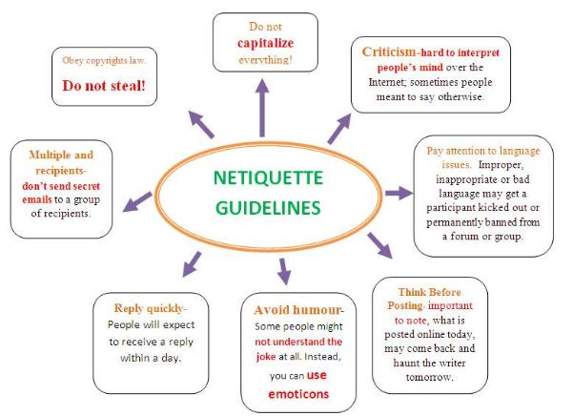
4.2 – Communication Technology – Email
Netiquette
Netiquette is a shortened version form of Internet etiquette, which refers to the need to respect other users’ views and display common courtesy when posting views in online discussion groups or when sending out emails. It is very important to consider what you write always since the reader can’t see your facial expressions or body language. What may have been intended as light could offend someone if they misunderstand your message and draw the wrong conclusions.
There are a number of rules governing netiquette, one such source is The Core Rules of Netiquette by Virginia Shea (1994).
What is CC and BCC? How does an email arrive at the receiver? Why does some spam get through and others don’t? What is email etiquette? Why is there a 10mb file size limit on emails? What is the next step on from emails? 30 years of emails and nothing is really new

Slide 30
4.2 – Communication Technology – Email Groups
10.1.3 – Email Groups
These are used for a number of purposes:
It is easier for a user to send out multiple emails of the addresses are all grouped together under a single name; the user then uses that single name in the ‘to’ box.
Companies can group people together for marketing purposes, e.g. according to age, ethnicity, hobbies, musical tastes etc. allowing them to target specific groups.
‘Spammers’ can create email groups by buying addresses of people from certain companies or from software that ‘raids’ address books on computers or email companies – this means that several thousand people can be sent spam by simply pressing the enter key.
Companies use email groups to set up meetings, e.g. video conferencing, to ensure that everybody concerned is invited to attend. It would be easy to forget someone if the addresses were typed in manually.
What is CC and BCC? How does an email arrive at the receiver? Why does some spam get through and others don’t? What is email etiquette? Why is there a 10mb file size limit on emails? What is the next step on from emails? 30 years of emails and nothing is really new

Slide 31
4.2 – Communication Technology – Internet
10.2.1 – The Internet
The Internet is a worldwide collection of networks that allows users to:
Send and receive emails
Chat online (using text, voice, and/or video)
Transfer files form computer to computer (using file transfer protocols – ftp’s)
Browse the web.
In 2015 it was estimated that 3bn people use the internet across the world. The internet is not actually owned by any single person or company. It is a concept rather than something tangible (something that can be touched) and relies of a physical infrastructure that allows networks to connect to other networks.
The world wide web (www) is only part of the internet which users can access by the way of a web browser. It contains a massive collection of web pages and has been based on the hypertext transfer protocol (http) since 1989. This web is a way of accessing information over the medium known as the internet; the two terms ‘www’ and ‘internet’ are not the same thing.
What is WWW and how big is it? How do I get to the top of the Google search? What is a Digital Footprint? What is a MAC and IP address? How many sites are dedicated to cats? When I press enter on a search, how does it find stuff? What are Bots and should I be scared?

Slide 32
4.2 – Communication Technology – Intranet
Many companies use an Intranet we well as the internet. An Intranet is defines as ‘a computer network based on internet technology but designed to meets the needs for sharing information within a single organisation or company.’ Access to an Intranet is usually confined to a company and, unlike the internet, is not available to the general public.
Intranets reside behind a firewall and are only accessible:
Internally to members of the company or
To people given various levels of access who are external to the company.
There are a number of reasons for adopting Intranets rather than using the internet:
Intranets are safer since there is less chance of external hacking or viruses
It is possible to prevent external links to certain websites.
Companies can ensure that the information available is specific to their needs
It is easier to send out sensitive messages in the knowledge that they will remain within the company.
Intranets offer better bandwidth than the internet thus there are fewer connection limits than the internet (the number of bits per second that can be transmitted are usually higher within an Intranet)
It is possible to create Extranets that allow Intranets to be extended outside the business but with the same advantages as an Intranet; this allows trading partners to have controlled access to some of the information (commercially sensitive information is password protected)

Slide 33
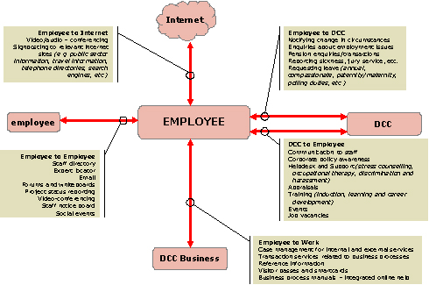
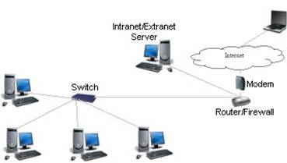
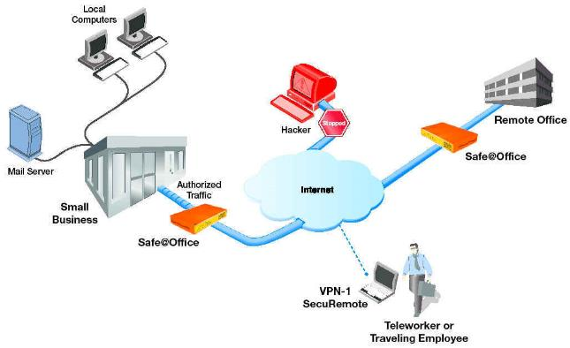
4.2 – Communication Technology – Intranet
Intranets
Extranets
Many large companies have an extranet to allow employees to work from home on a secure network.

Slide 34
4.2 – Communication Technology – Intranet
What is the difference between the Internet and an Intranet
The term ‘Internet; comes from the phrase International Network.
The term ‘Intranet; comes from the phrase Internal Restricted Access Network.
An Intranet is used to give local information relevant to the company whereas the Internet covers topics of global or general interest.
It is possible to block certain websites using an Intranet; while this is also possible with the Internet, it is more difficult.
An Intranet requires password and User ID entry and can only be accessed from agreed points/computers; the Internet can be accessed from anywhere in the world provided the user has an ISP account.
An Intranet is behind a firewall, which gives some protection against hackers, viruses and so on; this is more difficult to do with Internet access since it is open on an international scale.
The Internet can be public access, whereas Intranets tend to be private access.
What is WWW and how big is it? How do I get to the top of the Google search? What is a Digital Footprint? What is a MAC and IP address? How many sites are dedicated to cats? When I press enter on a search, how does it find stuff? What are Bots and should I be scared?

Slide 35
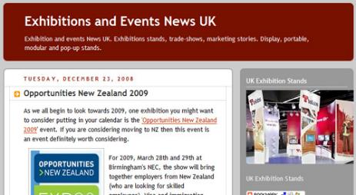
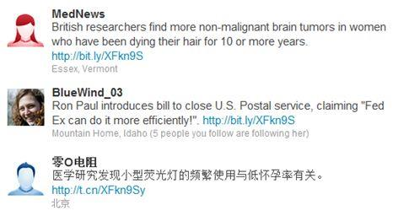
4.2 – Communication Technology – Blogs
Blogs (web logs)
These are personal internet journals where the writer (blogger) will type in their observations on some topic (i.e. latest movie reviews) and perhaps provide links to some relevant websites.
Blogs tend to range from minor projects (such as rock star performances) through to important social issues. However, the comments made on blogs are not immune from the law; bloggers can still be prosecuted for writing offensive material.
Features of Blogs:
Updated on a regular basis by the author
Usually organized in reverse chronological order (most recent to least recent)
Normally public – anyone can read them
Entries normally come from a single author
Other internet users can’t change blogs – they can only read them.
Microblogs – similar to blogs but are most often used on social networking sites to make short, frequent posts. The posts can be done using instant messaging, emails or other social networking vehicles (e.g. tweets). Social networking sites use microblogs to allow members to update their personal profiles.
Another version is a b-blog short for business blog, which is used by businesses to promote themselves on the Internet.

Slide 36
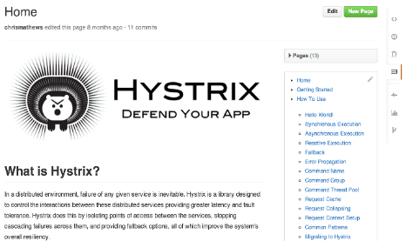
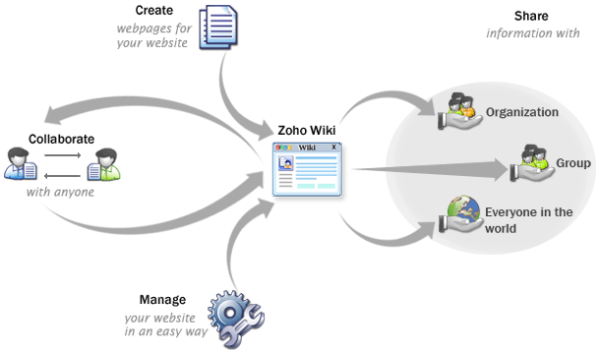
4.2 – Communication Technology – Wikis
Wikis
These are web based applications or websites that allow users to create and edit web pages using any web browser. A wiki will support hyperlinks and uses a very simple syntax (known as wiki markup) to create pages. They are often described as ‘web pages’ with an <edit> Button.’
Features of Wikis:
Anyone can edit, delete or modify the content
Many authors can be involved in a wiki
It is possible to organize a page any way that the author(s) wishes.
Shows/keeps track of all entries – i.e. stores a document history
Can be easily edited using a web browser
Allows large documents to be seen by many people – it is easier than emailing several people.

Slide 37
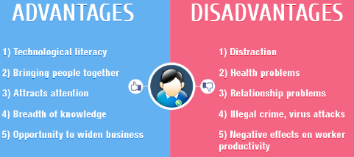
4.2 – Communication Technology – Social Networking
Social Networking Sites
These sites focus on building online communities of users who share the same interest and activities. They enable people to share photos, videos and music, hobbies, favourite eating places etc. The members do this by creating public profiles and thus form ‘relationships’ with other users but there are obvious dangers.
Features on Social Networking Sites:
Each member is provided with free web space
Each member can build their own private and public profiles
It is possible to upload content such as text messages, photos and videos.
It is possible to ‘write on each others walls’
Members are given free instant messaging and video chatting
It is possible to email other members within the community
Members can create pages where they can post photos, articles and so on
It is possible to invite people to become friends
Members have control over who can access their private or personal data.

Slide 38
4.2 – Communication Technology – Scenarios
Clare is a student looking for a work experience placement over the Summer holidays. There are a number of IT companies local to her area and she is unsure which communication method she should use to make the best impression. | A new driver has just passed their driving test and wants to keep friends and family up to date about their driving adventures. Suggest a communication method. | Technical Solutions secretary has been asked by the managing director to inform all staff that there will be a staff meeting a week on Thursday. Everyone must be present. Technical solutions staff have access to email and instant messenger. Some staff are known not to read either on a regular basis. | A website development company are running a promotional upgrade offer to new and existing customers for two weeks only. The company is considering which communication method would be best to launch their advertising campaign. | A junior clerk, Sam has had a new idea of how to deliver training to other colleagues in a large company. Sam’s line manager is so impressed that they told Sam to pass on his idea to Senior management. Suggest a communication method for Sam to use.
Desktop Upcycles is a medium sized company that rebuilds donated desktops PCs to pass on to charitable organisations. The company has renewed its policies for health and safety and mobile phone usage at work. All employees need to read and sign the new policies. | A software development company director has been late to the start of important meetings. She requires a method of organising her daily schedule in order to prevent future late arrivals. | An international company based in the UK and the US have a team of employees that need to regularly communicate together. Due to the nature of their business, decisions need to be made quickly but consultation is essential. They have tried to use video conferencing but they found that a quick two-minute question would turn into a 30 minute meeting. Can you suggest an alternative? | Mohammed is an IT apprentice for a local business MobApps. Mohammed attends college one day a week. In order for Mohammed to pass his latest college assignment his tutor has asked Mohammed to keep an accurate record of all the activities he is involved with at MobApps. | A college tutor is running an eight week computer skills course. He will conduct the initial skills audit meetings with individual students face to face in the first two weeks. The rest of the course will be completed online. At the end of the eight weeks the tutor must have another meeting to confirm to each student they have passed the course. The students are based all over the UK and do not have the time or funds to meet face to face with the tutor again. Suggest and justify an alternative.

Slide 39
4.2 – Communication Technology – Scenarios
Task 06 – Using the previous table, choose the communication technology appropriate for the given scenario and justify the technology.
Scenario | Communication technology | Justification
A
B
C
D
F
G
H
I
J

Slide 40
4.3 – Personal attributes and job roles
Now every job involves being a leader but the qualities of a leader are admired and recognised in any job. Good leadership requires deep human qualities, not necessarily management processes.
Here are the six leadership styles Goleman uncovered among the managers he studied, as well as a brief analysis of the effects of each style on the corporate climate:
The pacesetting leader - Expects and models excellence and self-direction. If this style were summed up in one phrase, it would be "Do as I do, now." The pacesetting style works best when the team is already motivated and skilled, and the leader needs quick results. Used extensively, however, this style can overwhelm team members and squelch innovation.
The authoritative leader - Mobilises the team toward a common vision and focuses on end goals, leaving the means up to each individual. If this style were summed up in one phrase, it would be "Come with me." The authoritative style works best when the team needs a new vision because circumstances have changed, or when explicit guidance is not required. Authoritative leaders inspire an entrepreneurial spirit and vibrant enthusiasm for the mission. It is not the best fit when the leader is working with a team of experts who know more than him or her.
The 3 leadership types, Autocratic, Democratic and Laissez-Faire Which leader is your Principal? Belgium without a Parliament for 4 years, do we need leaders. Dragon’s Den and leadership styles What happens in a Partnership? The problems when a leader is not good. Leadership change and company sales

Slide 41
4.3 – Personal attributes and job roles
The coercive leader - Demands immediate compliance. If this style were summed up in one phrase, it would be "Do what I tell you." The coercive style is most effective in times of crisis, such as in a company turnaround or a takeover attempt, or during an actual emergency like a tornado or a fire. This style can also help control a problem teammate when everything else has failed. However, it should be avoided in almost every other case because it can alienate people and stifle flexibility and inventiveness.
The democratic leader - Builds consensus through participation. If this style were summed up in one phrase, it would be "What do you think?" The democratic style is most effective when the leader needs the team to buy into or have ownership of a decision, plan, or goal, or if he or she is uncertain and needs fresh ideas from qualified teammates. It is not the best choice in an emergency situation, when time is of the essence for another reason or when teammates are not informed enough to offer sufficient guidance to the leader.
The 3 leadership types, Autocratic, Democratic and Laissez-Faire Which leader is your Principal? Belgium without a Parliament for 4 years, do we need leaders. Dragon’s Den and leadership styles What happens in a Partnership? The problems when a leader is not good. Leadership change and company sales

Slide 42
4.3 – Personal attributes and job roles
The affiliative leader - Works to create emotional bonds that bring a feeling of bonding and belonging to the organization. If this style were summed up in one phrase, it would be "People come first." The affiliative style works best in times of stress, when teammates need to heal from a trauma, or when the team needs to rebuild trust. This style should not be used exclusively, because a sole reliance on praise and nurturing can foster mediocre performance and a lack of direction.
The coaching leader - Develops people for the future. If this style were summed up in one phrase, it would be "Try this." The coaching style works best when the leader wants to help teammates build lasting personal strengths that make them more successful overall. It is least effective when teammates are defiant and unwilling to change or learn, or if the leader lacks proficiency.
Task 07 - Analyse their own leadership style by completing the quiz on the web page: http://www.skillsyouneed.com/ls/index.php/325444
The 3 leadership types, Autocratic, Democratic and Laissez-Faire Which leader is your Principal? Belgium without a Parliament for 4 years, do we need leaders. Dragon’s Den and leadership styles What happens in a Partnership? The problems when a leader is not good. Leadership change and company sales

Slide 43
4.3 – Personal attributes and job roles
Knowing your personal skills from the previous tasks and your leadership style from task 07, you need to find an IT job you like and decide whether you have the skills, personality and personal attributes for that job. You will clearly not have the qualification as yet but analyse the job most suitable for your needs on the web page: http://www.computerhope.com/issues/ch000764.htm or from the list below.
Task 08 – Create a report that demonstrates your personal skills, attributes and leadership style in relation to a specific job.
At the end of the activity you should be able to identify which type of IT job role is most suited to you.
The 3 leadership types, Autocratic, Democratic and Laissez-Faire Which leader is your Principal? Belgium without a Parliament for 4 years, do we need leaders. Dragon’s Den and leadership styles What happens in a Partnership? The problems when a leader is not good. Leadership change and company sales
3D Animation or Graphic design | Customer service | Data Entry | Database | Technical Support (Technician or Help Desk) | Hardware
Electronics technician or engineer | Networking or System Administrator | Security expert | Sales | Webmaster or Web Designer | Freelancer
Programmer or Software developer | Repair and fix | Quality Assurance (QA), System analyst or Tester |  | Technical Writing | Engineer

Slide 44
4.4 – Ready for work
Now with all your skills and attributes decided, the next stage in getting any job is to go through the interview stage. This is the hardest part of the process, the make or break and preparation is everything.
Step 1 - First could find an IT job vacancy online and prepare for interview.
Step 2 - Prepare a script of the questions they are likely to be asked and have answers prepared.
For this create a list of 20 questions specific about the job, attributes, qualifications, experience, promotion prospects etc. and prepare an answer for each using potential interview techniques.
Step 3 - Role-play the interview process with a partner or by recording the questions with an appropriate gap..
At the end of the activity you should have a greater understanding of the interview process and preparation required.
Appropriate IT jobs can be found here:
http://www.monster.co.uk/jobs/q-it-jobs.aspx?intcid=swoop_TopNav_Jobs_by_Industry_IT_Jobs
Task 09 – Create a script, response and interview practice for a specific ICT Job.
The 3 leadership types, Autocratic, Democratic and Laissez-Faire Which leader is your Principal? Belgium without a Parliament for 4 years, do we need leaders. Dragon’s Den and leadership styles What happens in a Partnership? The problems when a leader is not good. Leadership change and company sales

Slide 45
4.5 – Professional Bodies
Professional bodies exist to oversee industries like Corgi with Gas, Woolmark with clothes. Within the IT profession in Britain there are two bodies that provide certification and support with ICT related subjects. In a similar way as Novell provides a certificate for Netware and Client software, IT qualification tell your employer that you are capable of doing a job, that you have a certificate that proves it.
You need to use the two professional body web pages http://www.bcs.org/category/1 and http://www.ukita.co.uk/ to complete a summary table of the purpose, benefits and limitations of each professional body to its members and employers.
At the end of the activity the learners would have completed a table comparing the benefits and limitations of BCS and UK IT Association.
Task 10 – Research the 2 professional IT bodies and demonstrate the Purpose, Benefits and Limitations of these bodies for Members and Employers.
The 3 leadership types, Autocratic, Democratic and Laissez-Faire Which leader is your Principal? Belgium without a Parliament for 4 years, do we need leaders. Dragon’s Den and leadership styles What happens in a Partnership? The problems when a leader is not good. Leadership change and company sales
 | Purpose | Benefits | Limitations
BCS | Members: Employers: | Members: Employers: | Members: Employers:
UK IT Association | Members: Employers: | Members: Employers: | Members: Employers:

Slide 46
4.6 – Industry Certification - Academic
You should be hoping to go to university to gain an Academic Qualification, this will teach you the core purposes and methods within an industry without the true experience, whereas Industry qualifications do the opposite, industry practice and skillsets but no for-knowledge.
Academic Qualifications include: Information Systems and Technology, Introduction to Programming with Databases, Object-Oriented Systems Development, Business Systems Analysis, Accounting Information Systems, Web Design and Development, Internet Business and Technology, IT Risk and Security Management, etc. See list here just from one university.
To do these courses requires a pathway, GCSE, A Level, 3 years University Undergraduate and possibly work experience along the way. For more complex courses this can take 4 or 5 years like Autocad professional design courses.
This usually then leads to a low level job within the business with the hope of fast tracking up the career ladder but not necessarily.
The 3 leadership types, Autocratic, Democratic and Laissez-Faire Which leader is your Principal? Belgium without a Parliament for 4 years, do we need leaders. Dragon’s Den and leadership styles What happens in a Partnership? The problems when a leader is not good. Leadership change and company sales

Slide 47
4.5 – Industry Certification - Industry
Industry qualifications include:
For networking – CCIE, CCNP, JNCIE-ENT, WCNA
SYSAdmin – LPIC, MSCE, RHCE, Server+
Helpdesk – ACPS, Microsoft Specialist, CompTIA A+
Hardware – Cisco CCT*, CompTIA A+
Linux - CompTIA Linux+, Oracle Linux OCA, RHCA
And the list goes on. See link here for details.
Task 11 – Each student will need to research the title “Industry certification is better than a degree” and use examples from the Internet to back up each side of the argument stating the pros and cons of both industrial certification and subject-based degrees..
Split learners into two groups:
Group 1 to research industry certifications and their benefits;
Group 2 to research academic qualifications and their benefits.
Set up a debate based on the motion ‘Industry certification is better than a degree’. Group 1 should come up with valid arguments for the motion and Group 2 should come up with valid arguments against the motion.
Task 12 - Research the motion ‘Industry certification is better than a degree’ on the internet. Are UK companies for or against the motion?
The 3 leadership types, Autocratic, Democratic and Laissez-Faire Which leader is your Principal? Belgium without a Parliament for 4 years, do we need leaders. Dragon’s Den and leadership styles What happens in a Partnership? The problems when a leader is not good. Leadership change and company sales

Slide 48
Exam Questions – Exemplar Paper
(o) Which of these communication methods would be most appropriate for tendering your resignation?
[1]
?
Communication Method | Tick
Letter
Social Networking Post
Text Message
Video Chat

Slide 49
Exam Questions – Exemplar Paper
Progress Mutual is a bank with eight branches, based in the West Midlands. Its main business is to provide savings accounts to local people.
The bank has been open for nearly 100 years and has over 500 000 customers. Many of these customers use a passbook that lists all of their transactions and is updated every time they visit a branch. A new online banking system has recently been launched and a number of customers have started to use this.
As well as a mainframe, the bank has a number of other servers housed in a data centre in its head office. It also has a back-up data centre in an off-site location.
5 Progress Mutual wants to employ a new network manager.
Describe two personal attributes that the new network manager should have and why they are needed.
1: ___________________________________________________________________________________
_________________________________________________________________________________________________________________________________________________________________________________________________________________________________________________________________________________________________________________________________________________________________________________________________________________________________________
2: ___________________________________________________________________________________
_________________________________________________________________________________________________________________________________________________________________________________________________________________________________________________________________________________________________________________________________________________________________________________________________________________________________________
[6]
?

Slide 50
Exam Questions – Exemplar Paper
(b) Progress Mutual has stated that the new network manager must work towards obtaining industry certifications.
Describe one benefit of the network manager having industry certifications.
_____________________________________________________________________________________
_____________________________________________________________________________________
_____________________________________________________________________________________
__________________________________________________________________________________ [2]
8 Progress Mutual sends marketing information to customers using email.
Explain two benefits to Progress Mutual of using email to send marketing information to customers.
1. ___________________________________________________________________________________
_____________________________________________________________________________________
_____________________________________________________________________________________
_____________________________________________________________________________________
2. ___________________________________________________________________________________
_____________________________________________________________________________________
_____________________________________________________________________________________
_____________________________________________________________________________________
[4]
?

